Slide 1
BA Training Day 8

Slide 2

Database concepts & SQL Overview
Basics of Databases, DBMS and Industry tools
Basic SQL commands for analysis
Joins
Group by and having condition
SQL Server/MySQL Installation
Data Mapping

Slide 3
Database concepts & SQL Overview?

Slide 4
The term database has fallen into loose use lately, losing much of its original meaning. To some people, a database is any collection of data items (phone books, laundry lists, parchment scrolls . . . whatever). Other people define the term more strictly.
Definition:
Database is defined as a self-describing collection of integrated
records. And yes, that does imply computer technology, complete with
programming languages such as SQL. A record is a representation of some physical or conceptual object.
Example:
You want to keep track of a business’s customers. You assign a record for each customer. Each record has multiple attributes, such as name, address, and telephone number. Individual names, addresses, and so on are the data.

Slide 5
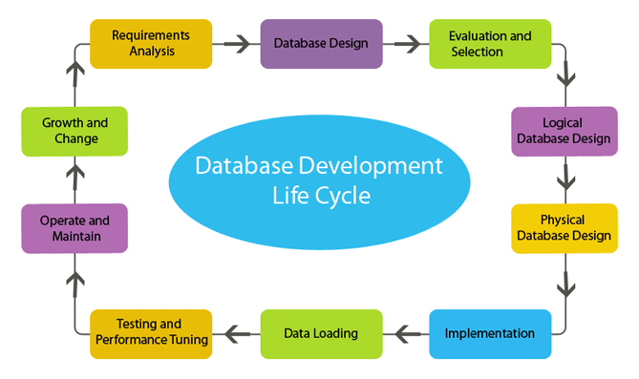
Database Development
Life Cycle?

Slide 6
Concepts Of Database?
Basic Concepts
A database is just what the name implies, a base collection of data. The data is organized in some manner so that the information contained within the database can be easily retrieved. Some of the simple databases that you might be familiar with are things like phone books or rolodexes. As data processing has become more sophisticated, so have methods for collecting, storing and retrieving information. Databases have become the cornerstone for an overwhelming amount of the computing environment in existence.

Slide 7
Basic Database concepts for the opening section
Field (Column): a single piece of information. Could be a name, or a number. In some cases, it may even be a null or empty value.
Record (Row): a collection of related fields. A number of pieces of information that relate to the same object.
For example: If you keep records on an employee, you might have their name, address, social security number, phone number, etc…Each piece of the information relates back to one employee. This would be the employee’s record.
Table (File): a collection of related records. If you put all the employee records together, you have a table of employees.

Slide 8
Database:
A collection of tables. If you were keeping the company records, you might have a table for employees, a table for customers, and another for sales records. All these tables would be combined as a database.
Relational Database:
A collection of related tables. The difference between a database and a relational database is in the way the tables are constructed. If you were keeping the company records on a series of Excel spreadsheets, you would have just a database. You could pull information from each table, but you wouldn’t have the ability to use information from one spreadsheet as a basis for asking questions about the information contained on another sheet. In a relational database, the tables are constructed so that there is a logical link between them. Based on the information that’s found in one table, you can follow this link and get relevant information from another table.

Slide 9
EXAMPLE OF A DATABASE VERSUS A RELATIONAL DATABASE
If you were keeping a simple database on Excel, you might have the following tables.
EMPLOYEE TABLE
Name | Employee Number | Hire Date
Bill White | 1122 | 1/1/2001
Ron Smith | 2387 | 9/27/2001
Greg King | 4456 | 8/24/1999
CUSTOMER TABLE
Name | Address | Phone Number
Lyons | 123 A Street | 916-444-5585
Dennys | 435 Elm Street | 916-478-2325
Bill White | 654 17th Avenue | 916-458-7714

Slide 10
EXAMPLE OF A DATABASE VERSUS A RELATIONAL DATABASE
If you were keeping a simple database on Excel, you might have the following tables.
ORDER TABLE
Customer Name | Order Number | Cost
Lyons | 101 | $23.78
Lyons | 145 | $145.25
IHOP | 152 | $54.89
As you can see, there is no way to relate the tables together. Each table contains information that corresponds to that table only.

Slide 11
EXAMPLE OF A DATABASE VERSUS A RELATIONAL DATABASE
In a relational database, the designer would build the tables so that there was a link between the tables. In a relational database, the tables above might be constructed to look like this:
EMPLOYEE TABLE
EmployeeID | Name | Hire Date
1122 | Bill White | 1/1/2001
2387 | Ron Smith | 9/27/2001
4456 | Greg King | 8/24/1999
CUSTOMER TABLE
CustomerID | Name | Address | Phone Number
100 | Bill White | 123 A Street | 916-444-5585
101 | Dennys | 435 Elm Street | 916-478-2325
102 | IHOP | 654 17th Avenue | 916-458-7714

Slide 12
EXAMPLE OF A DATABASE VERSUS A RELATIONAL DATABASE
ORDERS TABLE
Order Number | Customer Number | SalesID | Cost
101 | 100 | 1122 | $23.78
145 | 100 | 2387 | $145.25
152 | 102 | 2387 | $54.89
Notice that a numerical identifier has been added to the first two tables and moved to the front in the last table. This number will become our primary key (more on this in a moment). Also notice that the keys from the employee table and the customer table are being carried in the orders table. This makes this collection of tables a relational database.

Slide 13
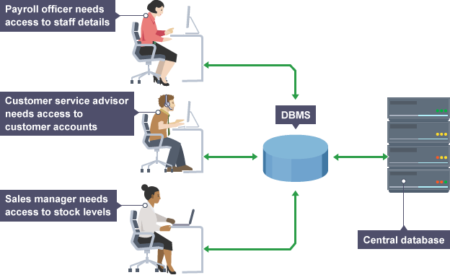
DBMS
A database management system (DBMS) is a set of programs
used to define, administer, and process databases and their associated
applications. The database being managed is, in essence, a structure that you build to hold valuable data. A DBMS is the tool you use to build that structure and operate on the data contained within the database.
A Relational Database Management System (DBMS) – software that allows users to create, maintain, and query your data in the related tables.

Slide 14
DBMS programs are:
Access, Microsoft SQL Server, Oracle, FoxPro, RBase, and Paradox, Cassendra, Posgres,Teradata
Common features of a DBMS
Creating and Adding of Data Structures
Query language
Reporting facility
Security, Control, Backup, and Disaster Recovery

Slide 15
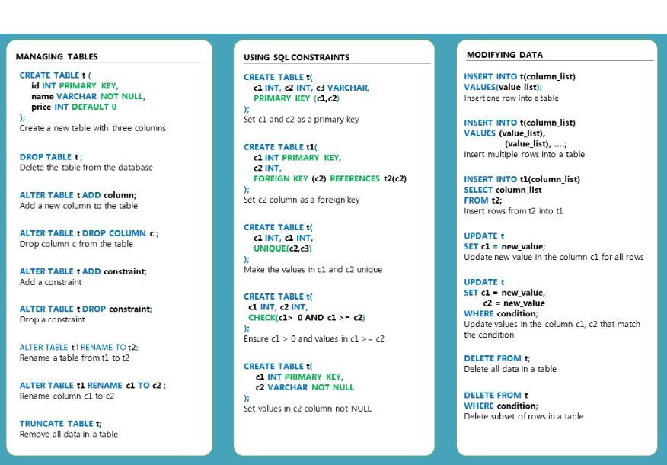
Basic SQL commands for analysis:

Slide 16
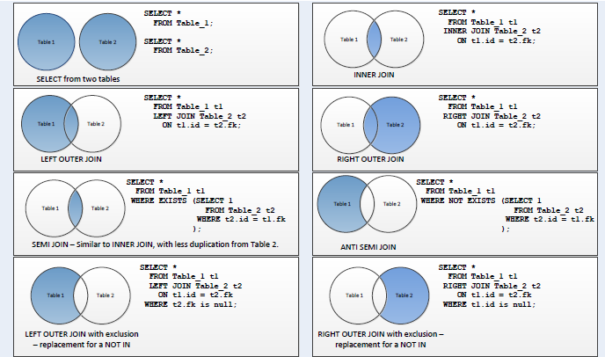
SQL Joins:

Slide 17
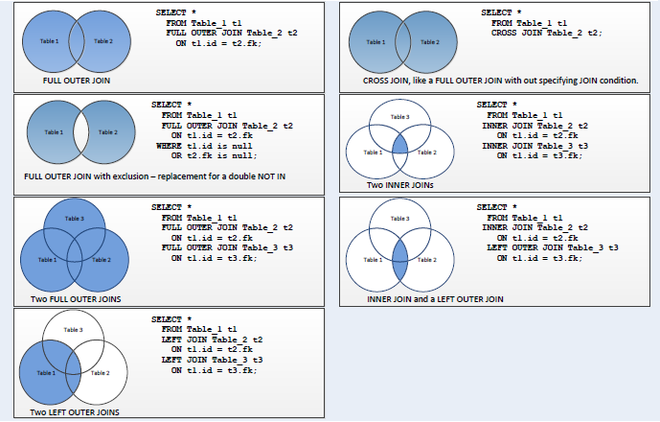
SQL Joins:

Slide 18
SQL Server/MySQL Installation

Slide 19
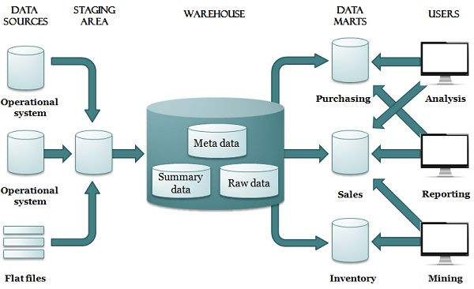
Data Mapping:

Slide 20
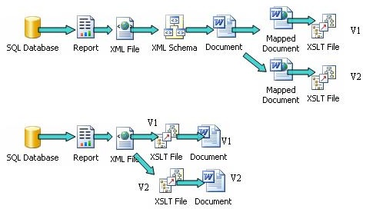
Data Mapping:

Slide 21


